Slide 1

How to install Flutter on Windows
Official documentation: https://docs.flutter.dev/get-started/install/windows
Requirements:
Windows 10 or later (64 bit)
About 30 GB free space on your disc
For tests on Android: an android phone connected via USB to your PC

Slide 2
Components to be installed
Android Studio (it is installing the Android SDK^{*)} too)
Flutter SDK^{*)} (tools, libraries, …)
Visual Studio Code used as IDE (Integrated Development Environment)
^{*)} SDK: Software Development Kit, Wikipedia says:
a collection of software development tools in one installable package.

Slide 3
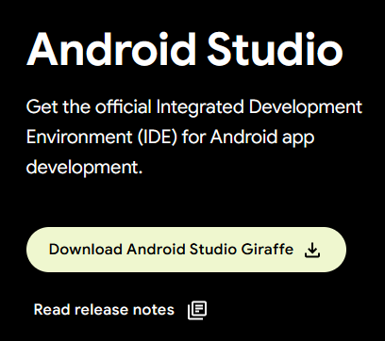
Download Android Studio
Open https://developer.android.com/studio :
Press the Download button, on next page confirm “Terms and Conditions”, then download android-studio-2022.3.1.19-windows.exe

Slide 4
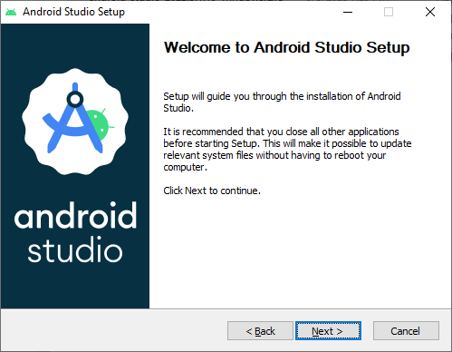
Install Android Studio (this may take more than 20 minutes)
Start “android-studio-2022.3.1.19-windows.exe” :

Slide 5
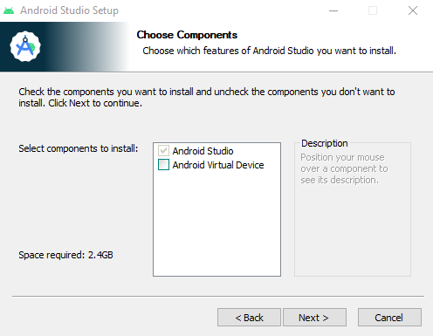
Unselect “Android Virtual Devices”, because it would need certain virtualization properties on your PC.

Slide 6
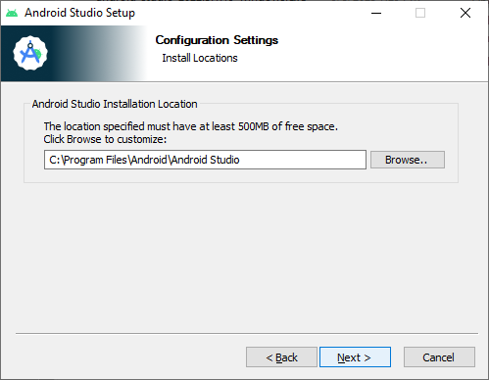
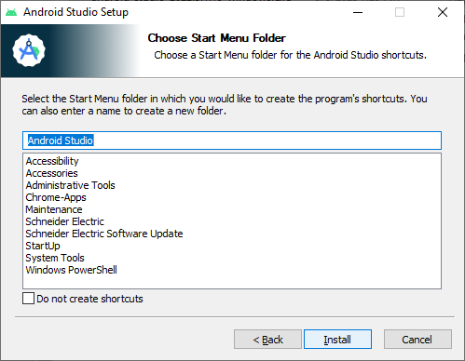
No changes needed in these 2 screens. Finally press on Install. After about 2 minutes:

Slide 7
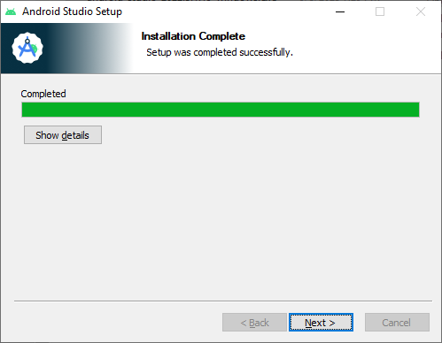
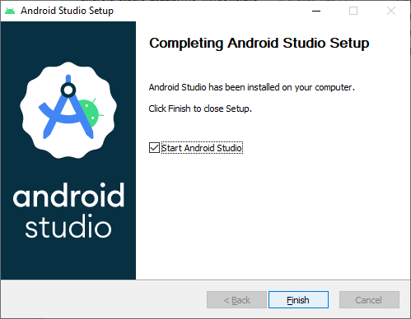
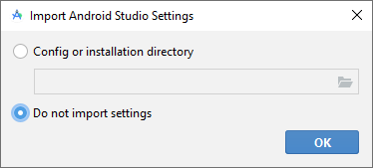
Press Next, then Finish. Wait until Android Studio starts. Do not import settings:

Slide 8
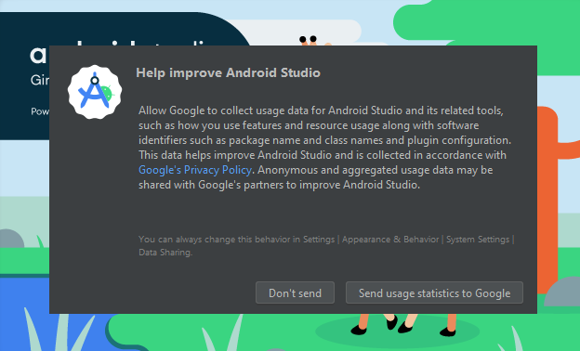
Decide yourself what to select here, I pressed “Don’t send”.

Slide 9
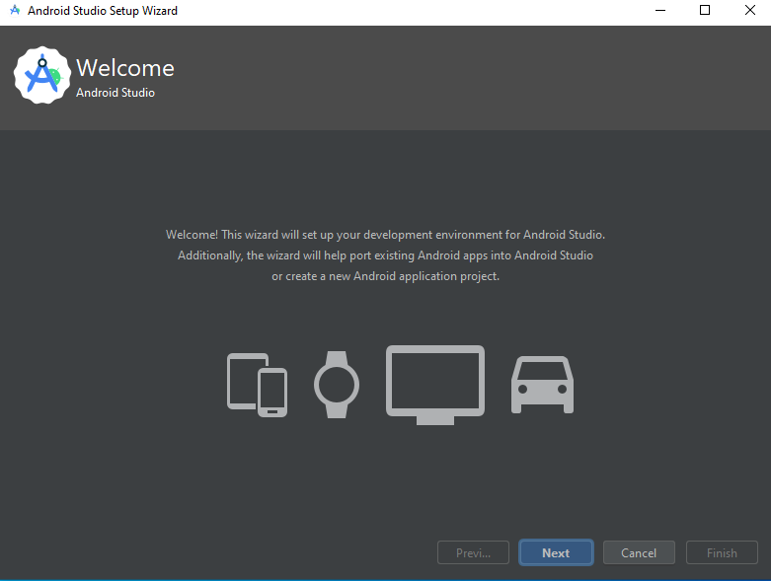
Press Next

Slide 10
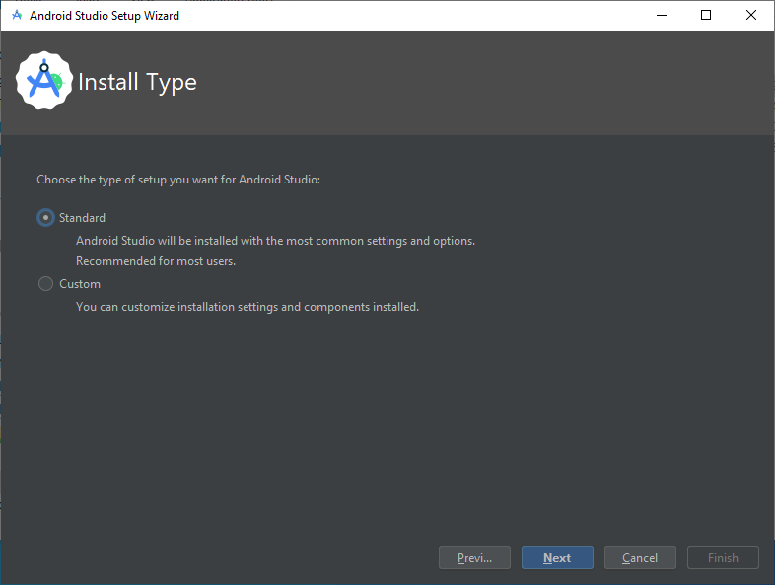
Press Next

Slide 11
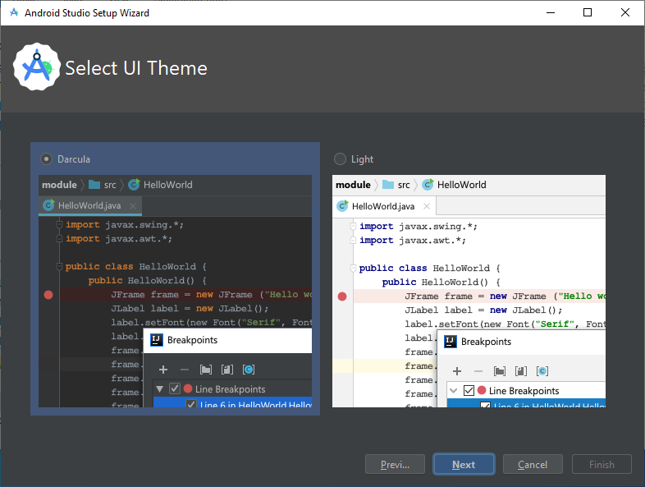
Decide if you prefer dark or light UI Theme.

Slide 12
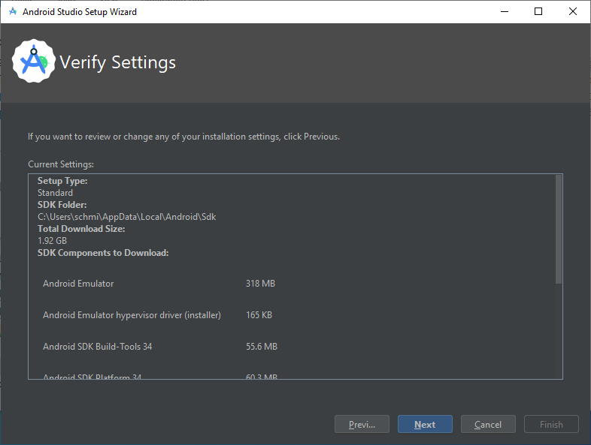
Press Next.

Slide 13
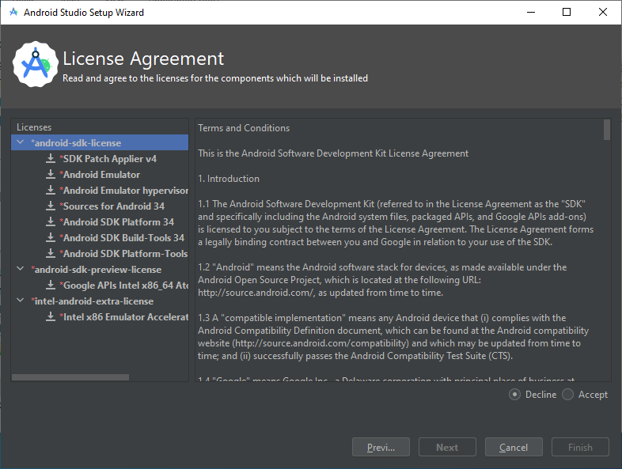
Click on “Accept” near bottom-right. Then select the second title line “android-sdk-preview-license” on the left and click again on “Accept”. Finally do the same with the third title line.

Slide 14
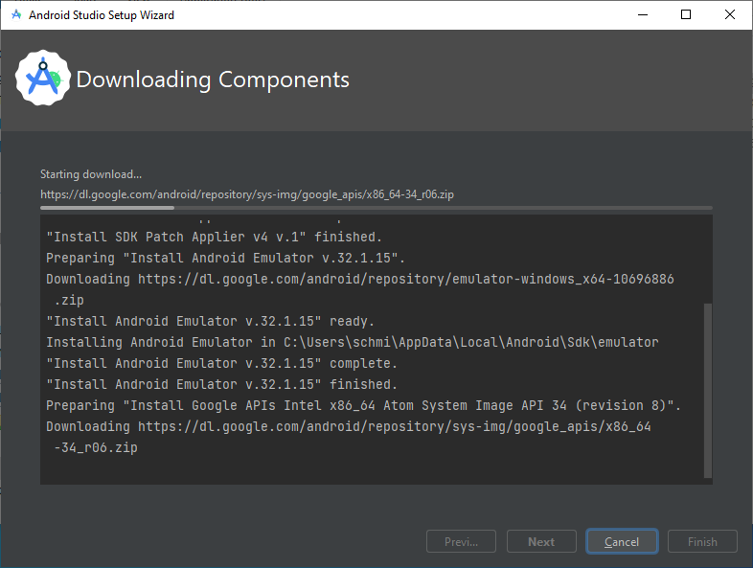
Be patient, this may take more than 5 minutes.

Slide 15
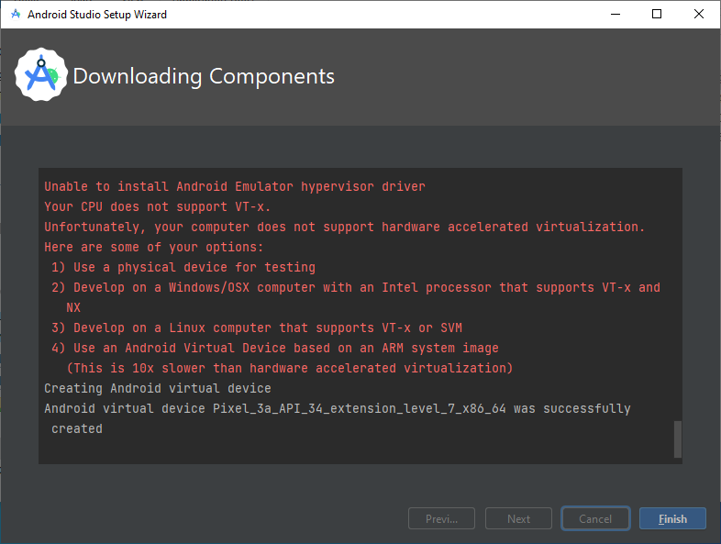
Ignore the red lines (we will use a physical phone for testing, no virtual device). Press on Finish and wait for Android Studio to start.

Slide 16
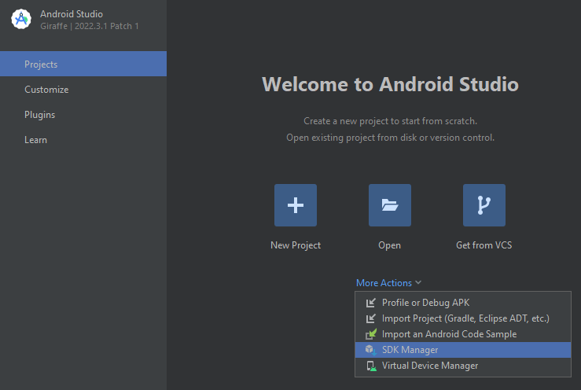
When Android Studio has started, open “More Actions” and select “SDK Manager”

Slide 17
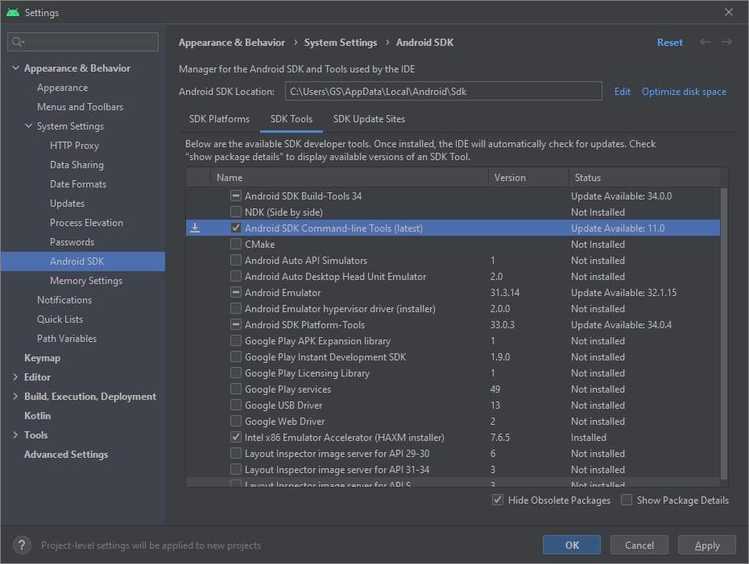
Open Tab “SDK Tools”, click on third line “Android SDK Command-Line Tools (latest)” and press OK.

Slide 18
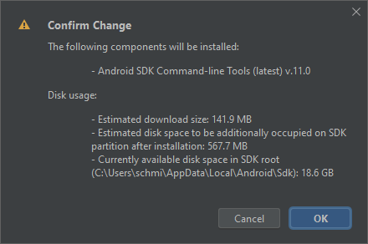
Press OK.

Slide 19
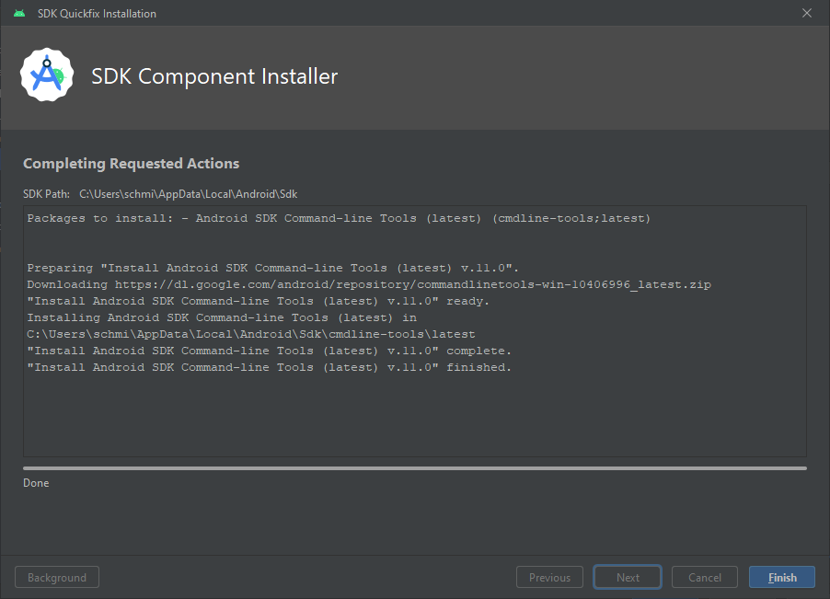
Wait until SDK Component Installer is done, then press on Finish.

Slide 20
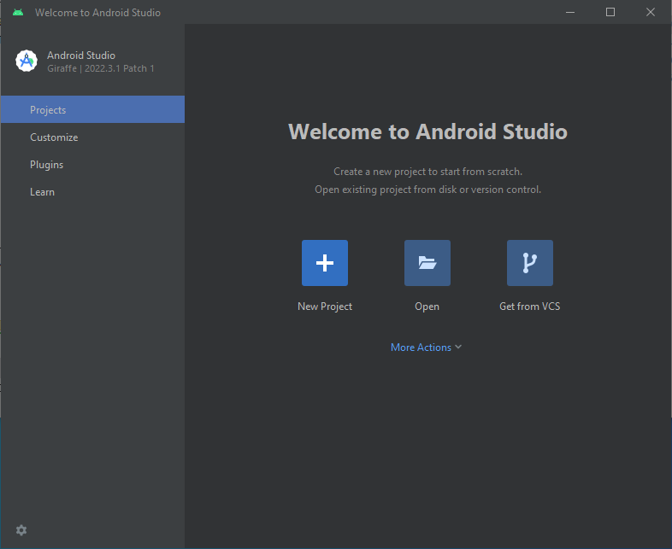
Quit Android Studio with the “x” Button top-right. We will use Visual Studio Code as development environment. Android Studio installer was used e.g. to get the Android SDK.

Slide 21
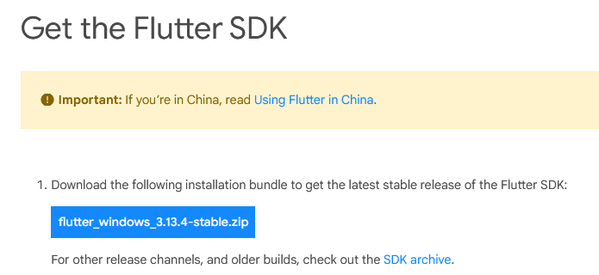
Download Flutter SDK
Open https://docs.flutter.dev/get-started/install/windows, scroll down a bit and press on the blue button shown below:
This will download the latest stable Flutter SDK as a zip-file.
The file has around 900 MB.

Slide 22
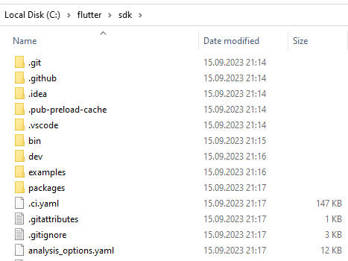
Unzip the Flutter SDK
Create a folder “flutter” on your drive “C:\” and therein a folder “sdk”. ^{*)}
Open the downloaded zip file with the Flutter SDK, go to folder “flutter” therein, select all directories and files and copy them to “C:\flutter\sdk”
^{*)} You can name the directories as you want,
but do not use blanks in their names.

Slide 23
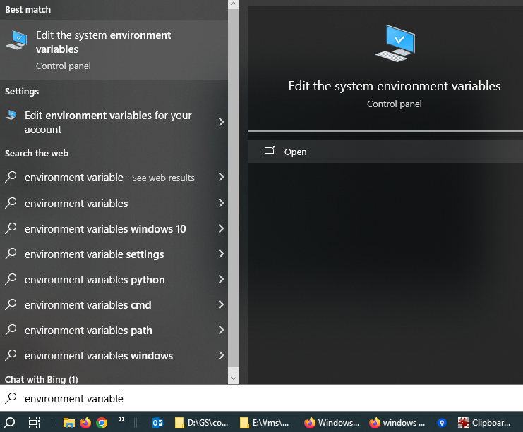
Add Flutter’s bin directory to PATH
In the Search area of the task bar, enter “environment variable” ^{*)} :
Press “Open” on the right.
^{*)} In a German Windows, enter “Umgebungsvariable”

Slide 24
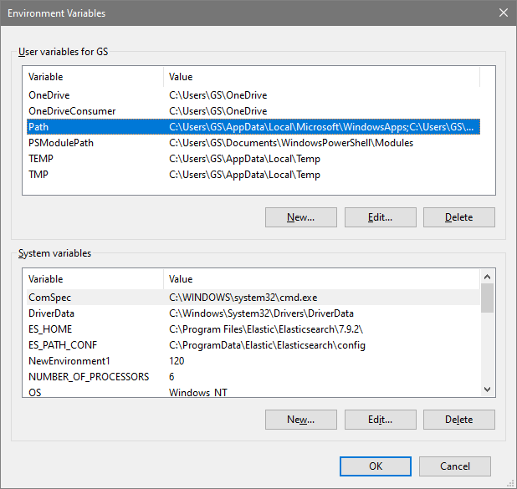
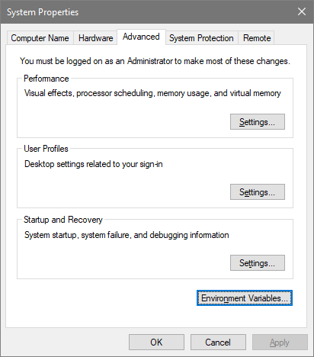
Press on “Environment variables” and in the upcoming window on the line starting with “Path”, then press “Edit…”

Slide 25
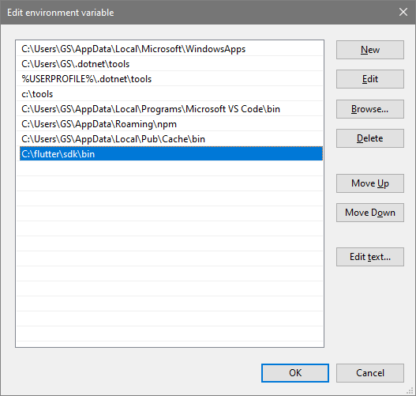
You may see other content than shown above. Press on New, in the highlighted line enter “C:\flutter\sdk\bin”, then press OK. This ensures that you can start the “flutter” command in each command prompt.

Slide 26
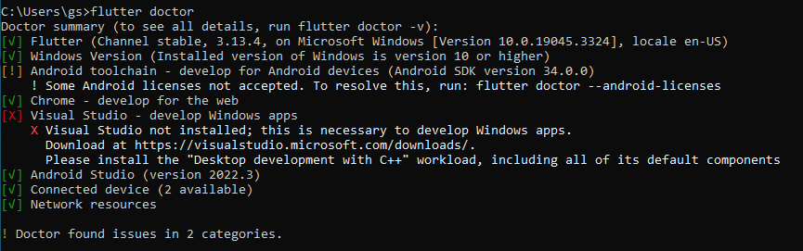
In the search area of the task bar, enter “cmd” and open a command prompt. Therein enter the command “flutter doctor”. Be patient, this command may take several minutes.
At the end you should see the output shown above.
The “red” issue is ok for us, we do not want to develop apps for Windows. Next page shows how to fix the “orange” issue.

Slide 27

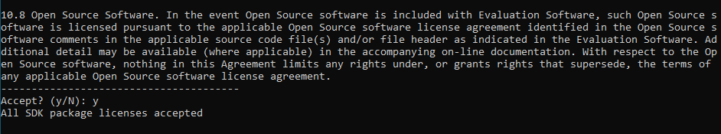
As proposed by “flutter doctor”, enter the command “flutter doctor –android-licenses”. You should see:
Enter “y” and repeat this 5 times until you see

Slide 28
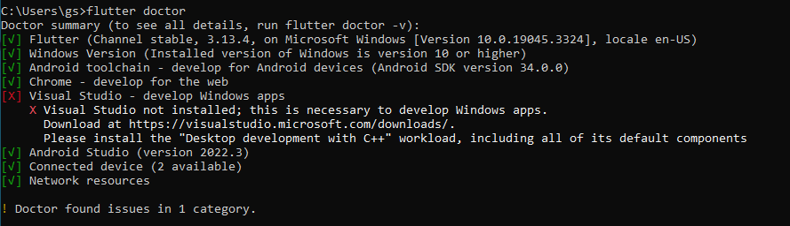
Now “flutter doctor” should only show the “Windows issue”:
Thus your system is prepared to develop flutter apps for Android or the web.
Next step is to install Visual Studio as IDE (Integrated Development Environment).

Slide 29
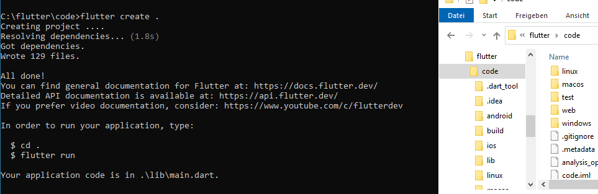
If you want, you can create and run Flutter apps even without an IDE.
“flutter create .” creates a new Flutter project in the directory, where this command is started:

Slide 30
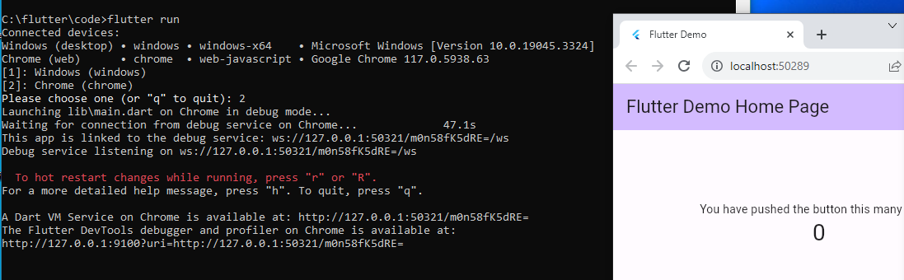
And “flutter run” starts this project e.g. on Chrome:

Slide 31
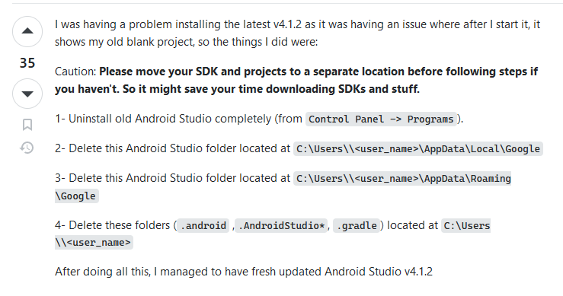
How to completely Un-Install Android Studio
This is in case you want to demonstrate the installation on a PC, where Android Studio was already installed.
Answer taken from:
https://stackoverflow.com/questions/39953495/how-to-completely-uninstall-android-studio-from-windowsv10

